Slide 1

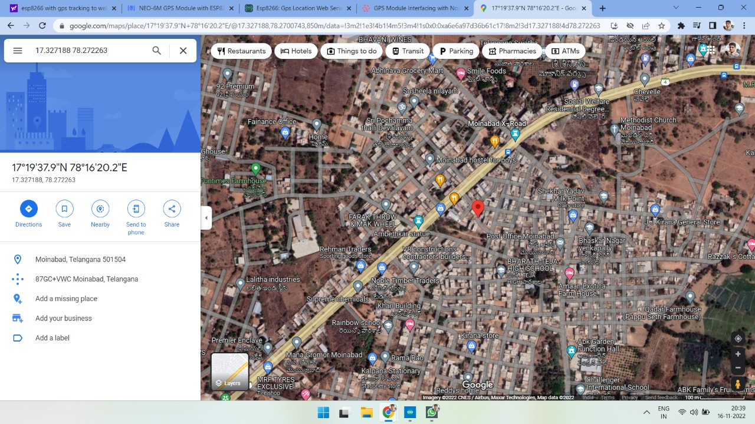
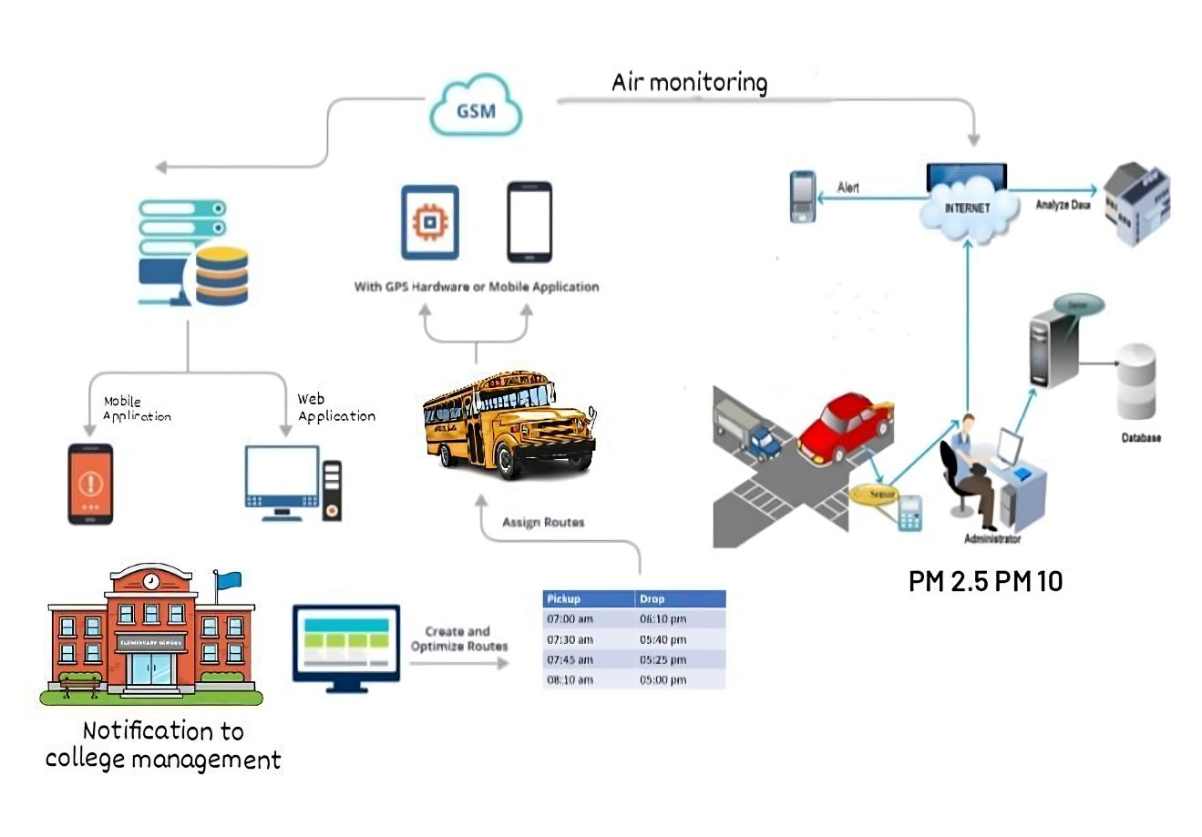
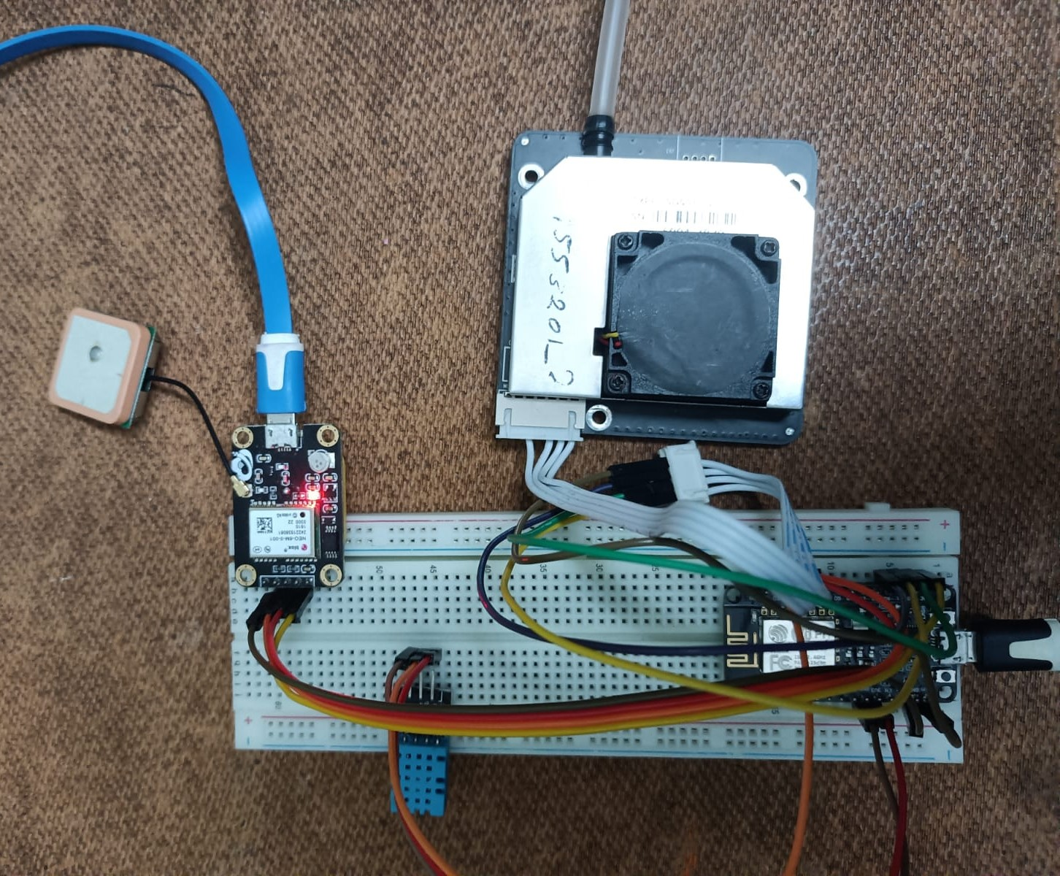
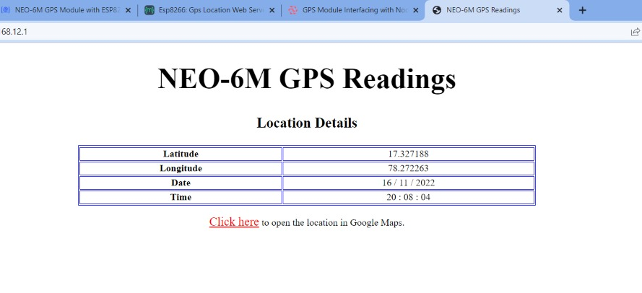
Mobile Air Pollution Monitoring and Bus Tracking
K. Manohar Reddy, N.V.V Ramana Reddy, P. Sai Karthika, R. Deepak Reddy
Department of Electronics and Communication Engineering
KG Reddy College of Engineering Technology, Hyderabad kankanalamanohar@kgr.ac.in, ramanareddy@kgr.ac.in, pylasaikarthika@kgr.ac.in, rakashideepakreddy@kgr.ac.in
Abstract
Aim/Objective
When the server IP address is searched in a browser it opens up the information tab, which consists of latitude, longitude data along with date and time. Here we can also observe a hypertext link. Clicking on it will redirect us to the location coordinates mentioned above and it will display on the google maps as shown below.
We need a smart and portable management system which provides us with an efficient method to track the current location of a bus and help the stakeholders with efficient time management. And also, air pollution levels are constantly on rise. So, a system is needed where we can constantly monitor the surrounding pollution levels. Instead of an inert system, we are proposing a more flexible one.
Combining present technology with the requirement of information transmission, we planned for a creative approach to track a bus and monitor the pollution levels at the same time using GPS and PM sensors. This system can also be used for Accident Detection Alert System, Soldier Tracking System and many more just by making a few changes in hardware and software.
Keywords­­- Tracking, GPS, Pollution, PM Sensor, Monitoring
The aim and objectives are to build an "Android application" which will help us track the bus locations and monitor the air pollution levels in the environment through a mobile application. To provide the information and location of bus and amount of pollution during the journey of various places to the stake holders for taking care and prior precautions.
Methodology
Impact and Outcome of the project
Conclusion
Introduction
Save human lives from potential risk
Saves time for people
It is a model for bus tracking unit with the help of GPS receivers and GSM modem and it is better scheduling or route planning can enable you handle larger jobs loads within a particular time. The air pollution monitoring will be done parallelly, the different areas have different levels of air quality at different times it is important for us to monitor what is happening. In this way we can identify trouble spots and ensure that we are taking the right steps. We have completed the project as per the requirements of our project.
The primary aim of this project is to track the bus location and monitor air pollution levels in the environment through a mobile application. When there is a bus failure on an ongoing journey, the passengers go into a dilemma whether to wait there for help to arrive or to move by private vehicle.
Nowadays, the increase in harmful gases in the atmosphere is causing damage to human life. Through an android application, we can track the current status of the bus, monitoring the air pollution levels and updating the status of those to the nearest corresponding departments.
Results and Discussion
After the completion of the project kit assembling and all the connections made, the results of how each sensor is working and uploading the data to the cloud server are as followed below:
References
[1] P. Das, S. Ghosh, S. Chatterjee and S. De, "A Low Cost Outdoor Air Pollution Monitoring Device With Power Controlled Built-In PM Sensor," in IEEE Sensors Journal, vol. 22, no. 13, pp. 13682-13695, 1 July1, 2022, doi: 10.1109/JSEN.2022.3175821.
[2] M. F. M. A. Hakeem, N. A. Sulaiman, M. Kassim and N. M. Isa, "IoT Bus Monitoring System via Mobile Application," 2022 IEEE International Conference on Automatic Control and Intelligent Systems (I2CACIS), 2022, pp. 125-130, doi: 10.1109/I2CACIS54679.2022.9815268.
[3] B. B. Humaïra and A. Chiniah, "An Adaptive Communication Model for Android Bus Tracking App," 2021 2nd Global Conference for Advancement in Technology (GCAT), 2021, pp. 1-6, doi: 10.1109/GCAT52182.2021.9587657.
[4] T. W. Ayele and R. Mehta, "Air pollution monitoring and prediction using IoT," 2018 Second International Conference on Inventive Communication and Computational Technologies (ICICCT), 2018, pp. 1741-1745, doi: 10.1109/ICICCT.2018.8473272.
To address the problem:
The difficulties faced by people when a bus fails or one fails to board the bus on time lead to confusion among the people. Also air pollution is one of the major environmental issues that cannot be ignored. Inhaling pollutants for a long time causes damage to human health.

